Slide 1
Trees traversal

Slide 2
In linear data structures (Array, Linked List, Queues, Stacks, etc) which have only one logical way to traverse them, trees can be traversed in different ways.
Notes:
Insert a map of your country.

Slide 3
Traversal is a process to visit all the nodes of a tree and may print their values too.
Because, all nodes are connected via edges (links) we always start from the root (head) node.
That is, we cannot randomly access a node in a tree.
Notes:
Insert a map of your country.

Slide 4
There are three ways which we use to traverse a tree −
In-order Traversal
Pre-order Traversal
Post-order Traversal
Notes:
Insert a map of your country.

Slide 5
In-order Traversal
An inorder traversal is a traversal technique that follows the policy, i.e., Left Root Right.
Here, Left Root Right means that the left subtree of the root node is traversed first, then the root node, and then the right subtree of the root node is traversed.
If a binary tree is traversed in-order, the output will produce sorted key values in an ascending order.
Notes:
Insert a map of your country.

Slide 6
Uses of Inorder Traversal:
In the case of binary search trees (BST), Inorder traversal gives nodes in non-decreasing order. To get nodes of BST in non-increasing order, a variation of Inorder traversal where Inorder traversal is reversed can be used.

Slide 7
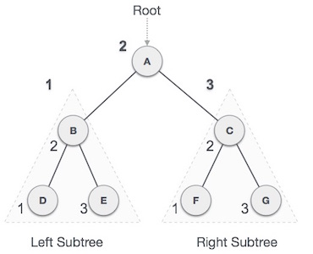
We start from A,
follow in-order traversal, we move to its left subtree B.
B is also traversed in-order. The process goes on until all the nodes are visited
D → B → E → A → F → C → G
Notes:
Insert a map of your country.

Slide 8
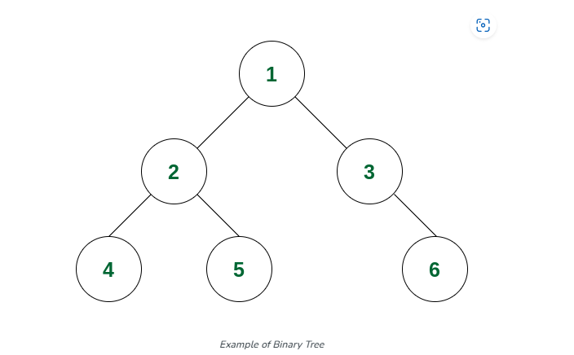
Consider below tree

Slide 9
In Above example we consider binary tree ,BUT for getting result in ascending order consider below elements .

Slide 10
IF create bst tree ,then result will be in ascdending order
ELEMENTS : 50 , 30 , 20 , 40 , 90 ,100
In this example create tree acc to BST property and perform transversing operation acc to inorder traversing method .

Slide 11
algorithm
Until all nodes are traversed −
Step 1 − Recursively traverse left subtree.
Step 2 − Visit root node.
Step 3 − Recursively traverse right subtree.
Notes:
Insert a map of your country.

Slide 12
Pre-order Traversal
In this traversal method, the root node is visited first, then the left subtree and finally the right subtree.
Notes:
Insert a map of your country.

Slide 13
Uses of Preorder
Preorder traversal is used to create a copy of the tree. Preorder traversal is also used to get prefix expressions on an expression tree.

Slide 14
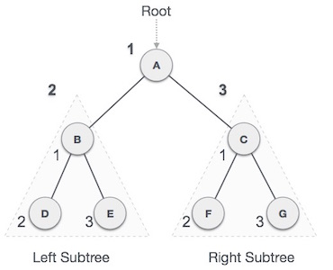
We start from A, and following pre-order traversal, we first visit A itself and then move to its left subtree B.
B is also traversed pre-order. The process goes on until all the nodes are visited. The output of pre-order traversal of this tree will be −
A → B → D → E → C → F → G
Notes:
Insert a map of your country.

Slide 15
Consider below tree

Slide 16
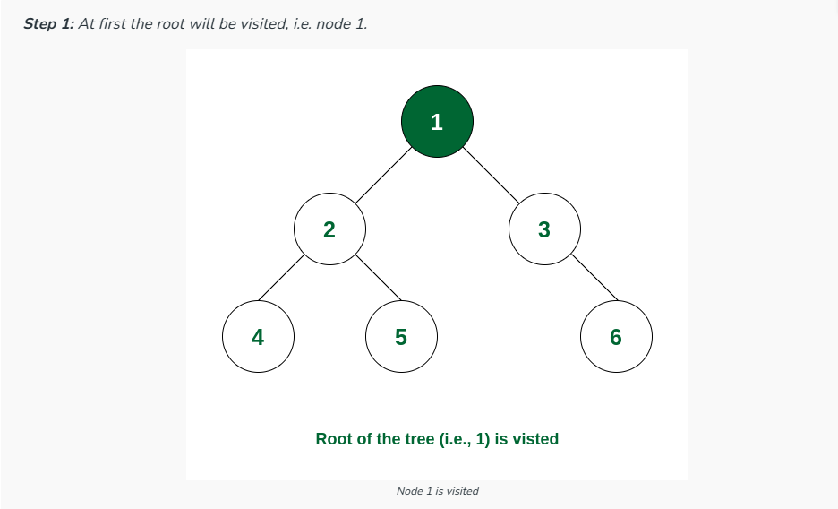

Slide 17
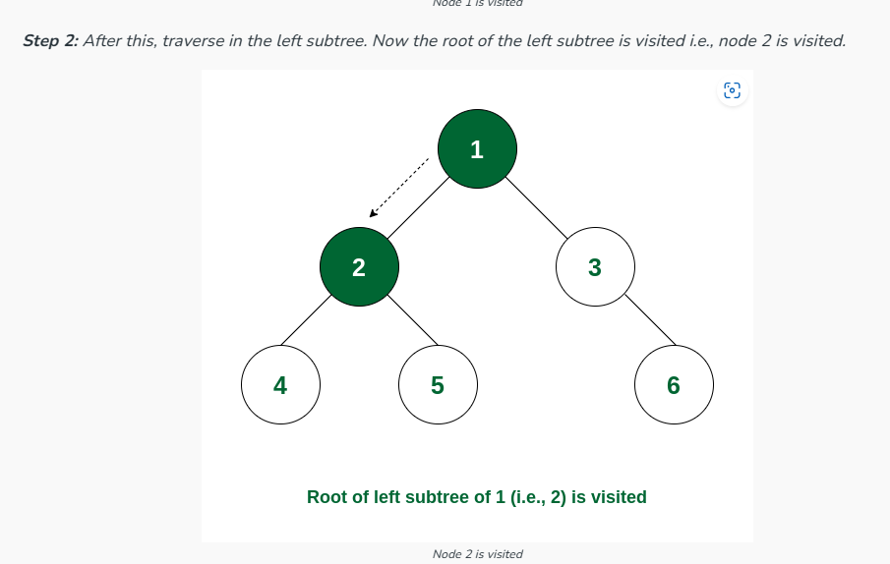

Slide 18
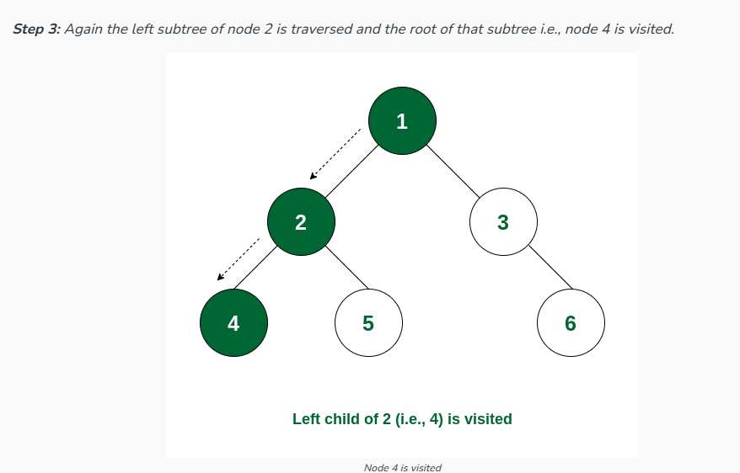

Slide 19
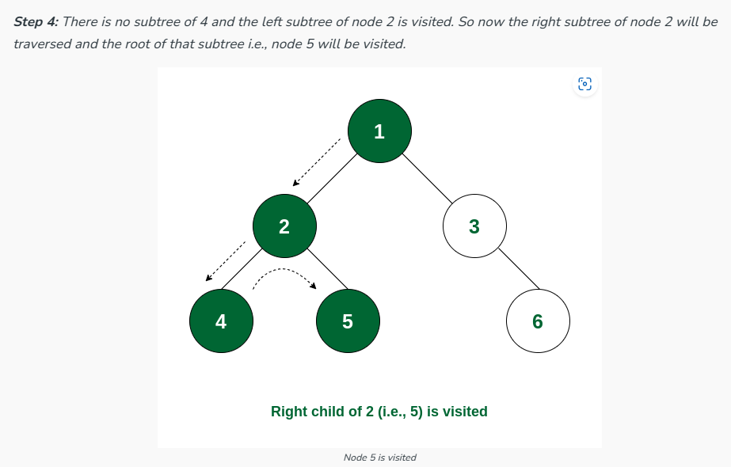

Slide 20
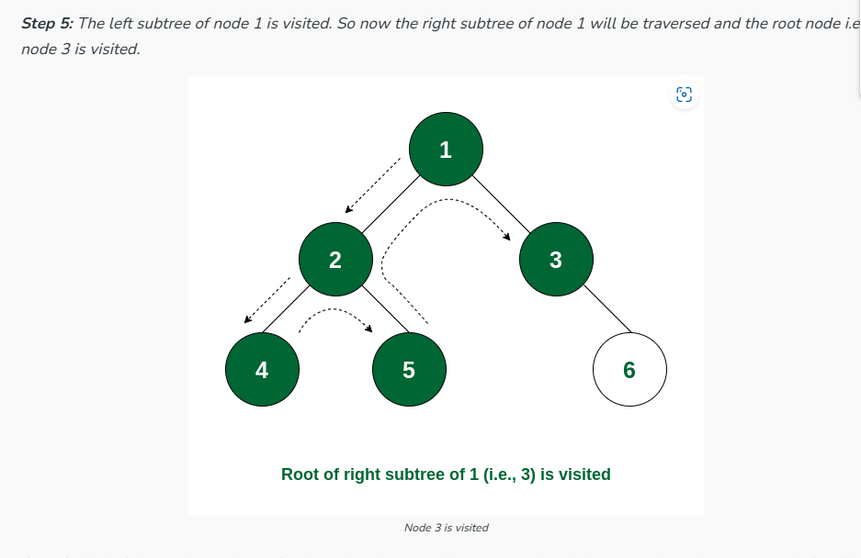

Slide 21
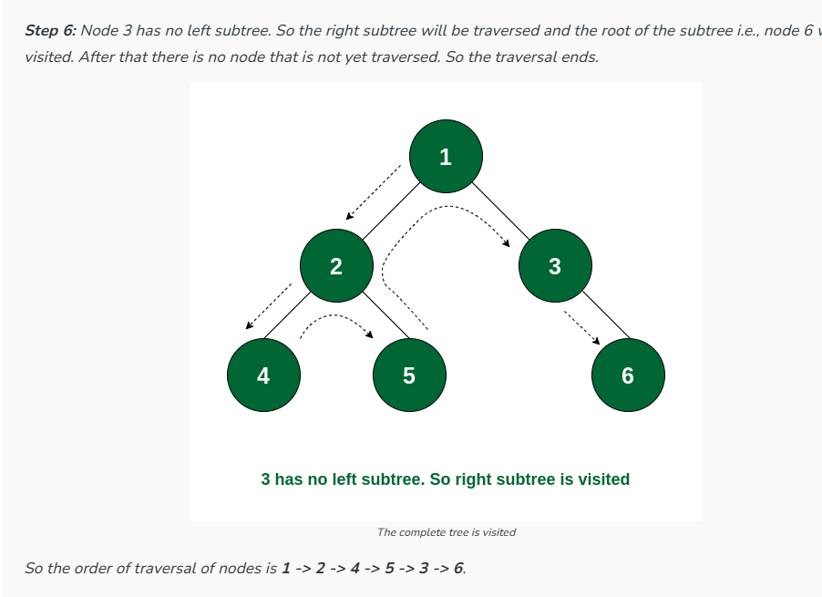

Slide 22
algorithm
Until all nodes are traversed −
Step 1 − Visit root node.
Step 2 − Recursively traverse left subtree.
Step 3 − Recursively traverse right subtree.
Notes:
Insert a map of your country.

Slide 23
Post-order Traversal
In this traversal method, the root node is visited last, hence the name.
First we traverse the left subtree, then the right subtree and finally the root node
Notes:
Insert a map of your country.

Slide 24
Uses of Postorder
Postorder traversal is used to delete the tree. Please see the question for the deletion of a tree for details. Postorder traversal is also useful to get the postfix expression of an expression tree

Slide 25
algorithm
Until all nodes are traversed −
Step 1 − Recursively traverse left subtree.
Step 2 − Recursively traverse right subtree.
Step 3 − Visit root node.
Notes:
Insert a map of your country.

Slide 26
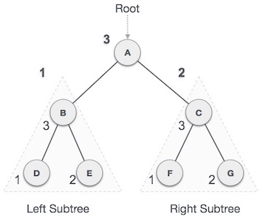
We start from A, and following Post-order traversal, we first visit the left subtree B. B is also traversed post-order. The process goes on until all the nodes are visited. The output of post-order traversal of this tree will be
D → E → B → F → G → C → A
Notes:
Insert a map of your country.

Slide 27
algorithm
Until all nodes are traversed −
Step 1 − Recursively traverse left subtree.
Step 2 − Recursively traverse right subtree.
Step 3 − Visit root node.
Notes:
Insert a map of your country.

Slide 28
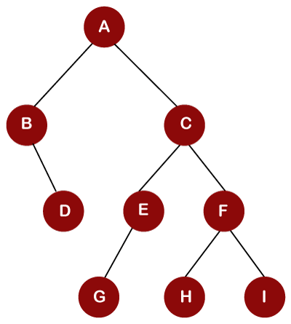

inorder traversal
First, we will visit the left part, then root, and then the right part of performing the inorder traversal
A is a root node, so we move to the left of the A, i.e., B.
As node B does not have any left child so B will be printed as shown
Notes:
Insert a map of your country.

Slide 29

After visiting node B, we move to the right child of node B, i.e., D.
Since node D is a leaf node, so node D gets printed as shown below
Notes:
Insert a map of your country.

Slide 30

The left part of node A is traversed. Now, we will visit the root node, i.e., A, and it gets printed as shown below:
Notes:
Insert a map of your country.

Slide 31

Once the traversing of left part and root node is completed, we move to the right part of the root node. We move to the right child of node A, i.e., C. The node C has also left child, i.e., E and E has also left child, i.e., G. Since G is a leaf node, so G gets printed as shown below:
Notes:
Insert a map of your country.

Slide 32

The root node of G is E, so it gets printed as shown below:
Notes:
Insert a map of your country.

Slide 33

Since E does not have any right child, so we move to the root of the E node, i.e., C. C gets printed as shown below
Notes:
Insert a map of your country.

Slide 34

Once the left part of node C and the root node, i.e., C, are traversed, we move to the right part of Node C. We move to the node F and node F has a left child, i.e., H. Since H is a leaf node, so it gets printed as shown below:
Notes:
Insert a map of your country.

Slide 35

Now we move to the root node of H, i.e., F and it gets printed as shown below:
Notes:
Insert a map of your country.

Slide 36

After visiting the F node, we move to the right child of node F, i.e., I, and it gets printed as shown below:
Notes:
Insert a map of your country.

Slide 37
Preorder Traversal
A preorder traversal is a traversal technique that follows the policy, i.e., Root Left Right. Here, Root Left Right means root node of the tree is traversed first, then the left subtree and finally the right subtree is traversed.
Here, the Preorder name itself suggests that the root node would be traversed first.
Notes:
Insert a map of your country.

Slide 38

To perform the preorder traversal, we first visit the root node, then the left part, and then we traverse the right part of the root node. As node A is the root node in the above tree, so it gets printed as shown below:
Notes:
Insert a map of your country.

Slide 39

Once the root node is traversed, we move to the left subtree. In the left subtree, B is the root node for its right child, i.e., D. Therefore, B gets printed as shown below
Notes:
Insert a map of your country.

Slide 40

Since node B does not have a left child, and it has only a right child; therefore, D gets printed as shown below:
Notes:
Insert a map of your country.

Slide 41

Once the left part of the root node A is traversed, we move to the right part of node A. The right child of node A is C. Since C is a root node for all the other nodes; therefore, C gets printed as shown below:
Notes:
Insert a map of your country.

Slide 42

Now we move to the left child, i.e., E of node C. Since node E is a root node for node G; therefore, E gets printed as shown below:
Notes:
Insert a map of your country.

Slide 43

The node E has a left child, i.e., G, and it gets printed as shown below:
Notes:
Insert a map of your country.

Slide 44

Since the left part of the node C is completed, so we move to the right part of the node C. The right child of node C is node F. The node F is a root node for the nodes H and I; therefore, the node F gets printed as shown below:
Notes:
Insert a map of your country.

Slide 45

Once the node F is visited, we will traverse the left child, i.e., H of node F as shown below:
Notes:
Insert a map of your country.

Slide 46

Now we will traverse the right child, i.e., I of node F, as shown below:
Notes:
Insert a map of your country.

Slide 47
Postorder Traversal
A Postorder traversal is a traversal technique that follows the policy, i.e., Left Right Root. Here, Left Right Root means the left subtree of the root node is traversed first, then the right subtree, and finally, the root node is traversed.
Here, the Postorder name itself suggests that the root node of the tree would be traversed at the last.
Notes:
Insert a map of your country.

Slide 48

To perform the postorder traversal, we first visit the left part, then the right part, and then we traverse the root node. In the above tree, we move to the left child, i.e., B of node A. Since B is a root node for the node D; therefore, the right child, i.e., D of node B, would be traversed first and then B as shown below:
Notes:
Insert a map of your country.

Slide 49

Once the traversing of the left subtree of node A is completed, then the right part of node A would be traversed. We move to the right child of node A, i.e., C. Since node C is a root node for the other nodes, so we move to the left child of node C, i.e., node E. The node E is a root node, and node G is a left child of node E; therefore, the node G is printed first and then E as shown below
Notes:
Insert a map of your country.

Slide 50

Once the traversal of the left part of the node C is traversed, then we move to the right part of the node C. The right child of node C is node F. Since F is also a root node for the nodes H and I; therefore, the left child 'H' is traversed first and then the right child 'I' of node F as shown below:
Notes:
Insert a map of your country.

Slide 51

Once the left part and the right part of node C are traversed, then the node C is traversed as shown below:
Notes:
Insert a map of your country.

Slide 52

In the above tree, the left subtree and the right subtree of root node A have been traversed, the node A would be traversed.
Notes:
Insert a map of your country.

Slide 53
Notes:
Insert a map of your country.

